Slide 1
Washington-Oregon Community Networking Group
Developing new business opportunities in Washington and Oregon
Monthly meeting
Monday, July 20, 2026
12:00 pm – 1:00 pm Pacific Time

Slide 2
What is Washington-Oregon Community Networking Group?
We are a community-based organization that serves both Washington and Oregon.
Our virtual monthly meeting is a welcoming space to learn, share information, and connect with small businesses and organizational representatives to start building business relationships and partnerships.
  During the first half of our meeting, we share and discuss opportunities to develop new business.
  In the second half of our meeting, we engage in facilitated networking, guided by our facilitators and advisors.

Slide 3
Our Facilitation Team
Ryan Taylor, Organizer & Facilitator
Golden Gift Consulting / GHS Communications Consulting | Management & Business Development Consultant | Communications & Marketing
Cedric Austin Organizer & Facilitator
Washington State Department of Enterprise Services Community Engagement Specialist Procurement Inclusion and Equity Program | Public Works Business Diversity Program |
Barbara Alexander-Brown, Guest Facilitator & Advisor
Washington State Department of Transportation| Economic Opportunities & Compliance Specialist – Interstate Bridge Replacement Project | Management & Business Development Expert
George Frost, Advisor
GW Frost & Associates LLC | Principal Consultant - Supplier Diversity & Business Development | Communications & Outreach | Community Engagement
Daniel Seydel, Advisor
Platinum Group & Entrepreneurial Institute of Washington | Principal Consultant - Management & Business Development Consultant
Veronica Ybarra, Moderator & Advisor
Golden Gift Consulting / GHS Communications | Small Business Consultant | Proposal Writing, Business Development | Communications & Marketing

Slide 4
Upcoming Business Opportunities

Slide 5
Interstate Bridge Replacement Project – Drop-In Sessions
UPCOMING: IBR has launched outreach drop-in sessions, where you can
  Learn more about what’s happening with recent and upcoming outreach efforts
  Find links to recent event recordings and presentations
  Get help navigating the IBR Vendor Portal.
Check out the IBR Vendor Portal for more information and new features like the Bulletin Board, where IBR posts resources that are valuable to the small business community. https://vendor.interstatebridge.org/Login

Slide 6
Interstate Bridge Replacement Project – Upcoming Events
September 3: Central Regional Contracting Forum & Conference
Time: 9 a.m. to 5 p.m.
Location / Format: Yakima, WA
September 15: Washington APEX and NAMC-WA: Bridge Building Block Session 3, Avoiding Common Pitfalls
Time: 8:30 to 10 a.m.
Location / Format: Virtual

Slide 7

Interstate Bridge Replacement Project – Upcoming Events
July 23: IBR Outreach Drop-in Hour
Time: 9 to 10 am
Location / Format: Virtual
August 11: Washington APEX and NAMC-WA: Bridge Building Block Session 2, Financial Considerations
Time: 8:30 to 10 am
Location / Format: Virtual

Slide 8
Washington-Oregon
Local Construction Projects

Slide 9
Building E Exterior Renovation at Carriage House Apartments
Pre-bid Meeting: Jul 29, 2026 @ 11:00am PT, Pre-Bid Conference Jobsite Address Carriage House Apartments, 3602 South 180th Street, SeaTac, WA 98188.
Question Deadline: Aug 12, 2026 @ 9:00am PT
Questions pertaining to the bid are to be sent via email to MichelleJ@kcha.org no later than seven (7) calendar days prior to bid due date. All responses shall be in the form of Addenda.
Bid Date: Aug 19, 2026 @ 11:00am PT
Address: King County Housing Authority, 600 Andover Park West, Tukwila, WA 98188
Start Date: Sep 18, 2026; End Date: Feb 15, 2027
Address: 3602 S 180th St, Seattle, WA 98188

Slide 10
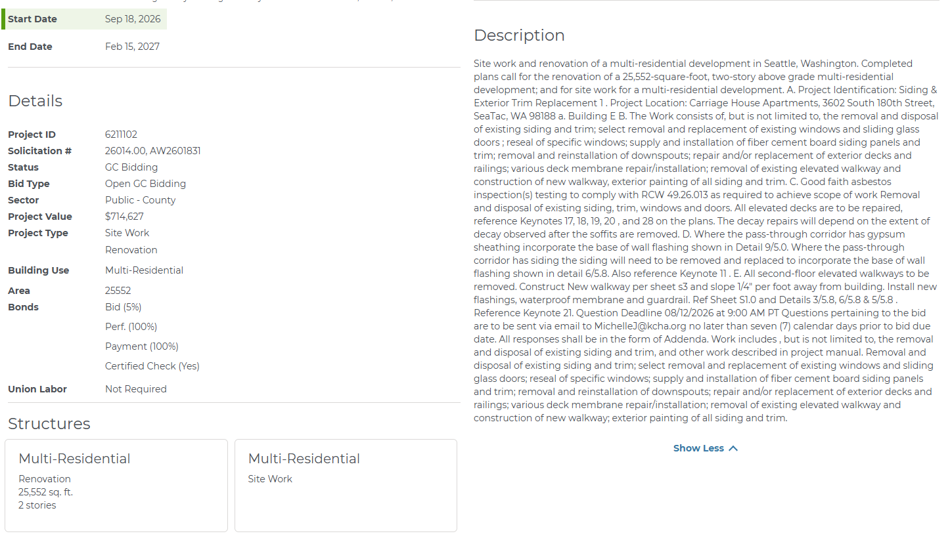
Project Details

Slide 11
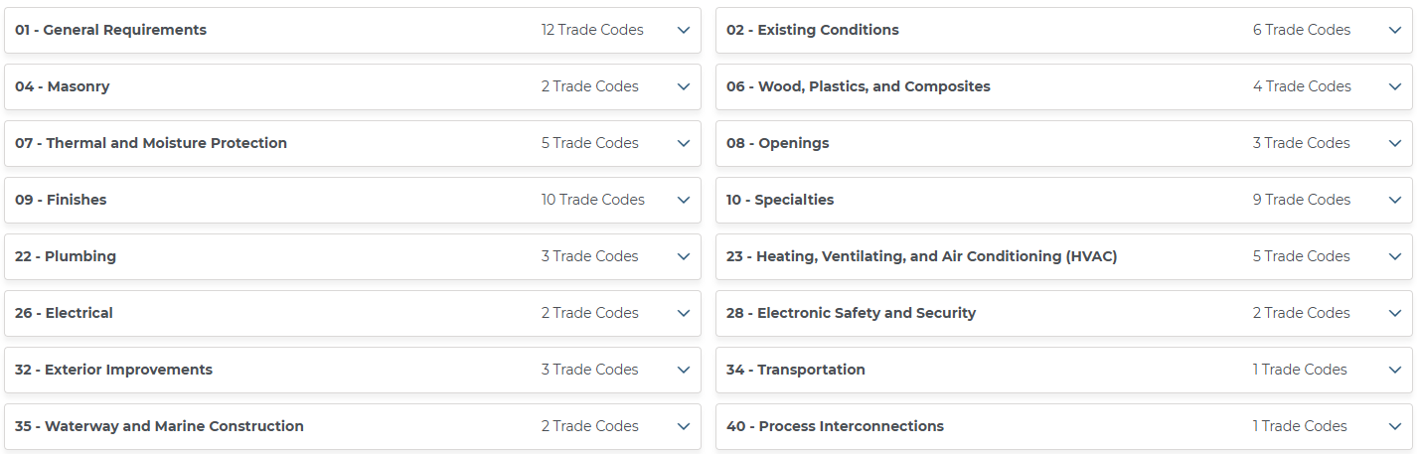
Construction Trades

Slide 12
RFP Contractor - Job Order Contracting General Construction Services
Pre-bid Meeting: Jul 29, 2026 @ 9:00am PT Mandatory - Room 107-108 of the
Bothell City Hall Building, 18415 101st Avenue NE, Bothell, WA 98011
Bid Date: Aug 18, 2026 @ 2:00pm PT - NPRSA Clerk's Office
RFP Date: Aug 18, 2026 @ 2:00pm PT - NPRSA Clerk
Start Date: Oct 17, 2026
Location: 18415 101st Avenue NE, Bothell, WA 98011

Slide 13
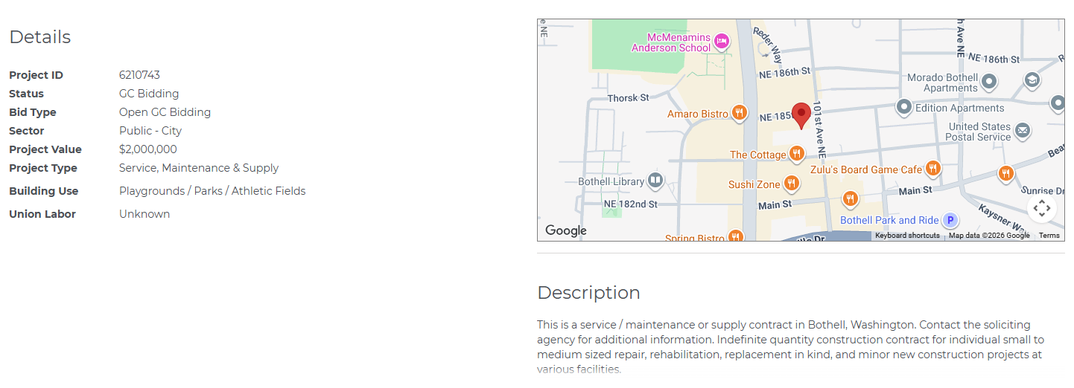
Project Details

Slide 14
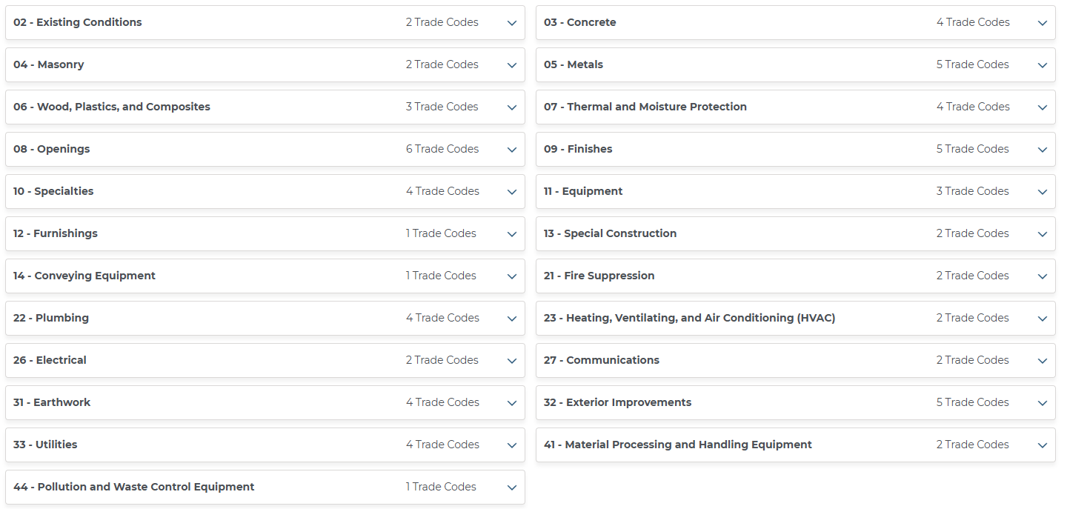
Construction Trades

Slide 15
Washington-Oregon
Local Consultant Projects

Slide 16

RFP 25-26 - Product to Market Program
Project Description:
The City of Vancouver is seeking proposals from qualified organizations to design, operate and sustain a Product to Market Program.
Questions Due Date: Aug 7, 2026, 4:00 PM PDT
Contact Information: Michael Woods, Michael.Woods@cityofvancouver.us
Close Date: Aug 19, 2026, 3:00 PM PDT
Days Left: 34
City of Vancouver
Project: Product to Market Program
Ref. #:RFP 25-26
Type: RFP
Status: Open
Open Date: Jun 23, 2026, 8:00 AM PDT

Slide 17
RFP 25-26 - Product to Market Program
In alignment with RCW 35.21.703, which affirms the authority of Washington cities to partner with nonprofit and community-based organizations to advance economic development, the City of Vancouver is soliciting proposals from qualified organizations to design, operate, and sustain a Product to Market Program (“Program”).
This Program is intended to support consumer-product entrepreneurs, particularly those from underserved communities. The goal of the program is to help early-stage enterprises transition into growth or revenue-stable businesses through multi-channel market access, including e-commerce, brick-and-mortar retail, and mobile vending pathways. The City seeks a program operator or consortium of partners capable of building a coordinated, infrastructure-backed ecosystem that connects entrepreneurs to production space, packaging, compliance, buyer, and distribution networks, while also providing specialized training, mentoring, and technical assistance
The Product to Market Program implements Goal 2, Action A of Vancouver’s Five-Year Economic Development Strategy (2026–2030), which prioritizes:
• Reducing barriers to entrepreneurship
• Expanding product to market pathways
• Strengthening small business success
• Building long-term community wealth
• Revitalizing neighborhood commercial districts
Goal 2 Action A: Enhance product market opportunities for local consumer product entrepreneurs Product placement with established brick-and-mortar and online retailers can help boost sales and brand reputation. Robust product to market programs provide critical support such as market research, packaging design, distribution strategies and access to retail partnerships, helping local consumer product entrepreneurs navigate the complexities of bringing products to market. The City will partner with local small business support organizations to launch new, or expand existing product to market programs, evaluate the availability of co-packing facilities and work with larger retailers to facilitate retail partnerships

Slide 18
RFP 25-26 - Product to Market Program
Product to Market Program – Expanded Framework
The Product to Market Program seeks to move entrepreneurs from informal or low-margin sales into scalable, compliant, revenue-producing businesses that generate household income, community wealth, and job creation.
Unlike traditional small-business assistance, this program is market-anchored—it does not simply train or mentor entrepreneurs, it also connects them to real sales channels, physical infrastructure, and purchasing pathways.
Potential Program Impact Goals
To be finalized alongside selected Program partner(s)
Increase visibility of local products across multiple channels.
Expand food truck and mobile vending presence in Vancouver.
Build long-term sustainable revenue for local small businesses.
Increased number of underserved entrepreneurs successfully launching or scaling their businesses.
Measurable improvements in business readiness, including packaging, branding, licensing, and compliance with regulatory requirements.
Strengthened peer-to-peer networks and mentorship opportunities.
Growth in local consumer product visibility.
Expand Inclusive Entrepreneurship
The program expands entrepreneurship not by recruiting more people to “start businesses,” but by removing the structural barriers that keep immigrant, BIPOC, and low-wealth founders from accessing formal markets.
In Vancouver, the binding constraints are not creativity or work ethic. They are:
Licensing and compliance complexity
Cost of and lack of access to certified kitchens and design packaging experts
Lack of retail buyer access
Limited English-language technical assistance
Absence of distribution and logistics networks
The Product to Market Program seeks to address these constraints by:
Embedding multilingual, culturally competent business navigators
Providing cohort-based technical assistance on topics ranging from licensing, food safety, insurance, and banking
Using cohorts and peer networks to replace isolation with collective learning and trust
The goal is to create a pipeline of businesses that are visible, bankable, and investable.

Slide 19
Port of Seattle – Project Opportunities
Main Terminal Improvement Program (MTIP) Emergency Power
Category: Consulting Services
Proposal Due Date: August 6, 2026, 12:00 PM
Pre-Proposal Conference: July 16, 2026, 9:00 AM, Virtual
Amount: Not to Exceed (NTE) $3.348M
Goal: WMBE Goal 15%
The MTIP – Emergency Power project is to provide National Electrical Code (NEC) Articles 700, 701, and 702 emergency power loads to the Main Terminal, C Concourse Expansion, South Concourse Evolution, and Parking Garages. The C Concourse Expansion and South Concourse Evolution projects will tie into this Emergency Power. The outcome of this procurement is a 30-percent design document (aka “bridging document”) that will be used to procure a design-build team. More Information
Pre-Conditioned Air Modular Bridge-Mounted Hose Trolley System Standardization
Category: Goods and Services
Proposal Due Date: August 11, 2026, 2:00 PM
Pre-Proposal Conference: July 17, 2026, 10:00 AM, Virtual
Amount: Award will be made to the Proposer offering the best value to the Port.
Goal: No goal (WMBEs and Small Businesses are encouraged to participate and pursue as the prime)
The Port of Seattle (the Port) is procuring Pre-Conditioned Air (PCA) Modular Bridge-Mounted Hose Trolley Systems to support aircraft pre-conditioned air delivery at Seattle–Tacoma International Airport (SEA). The purpose of the system is to improve airflow, reduce hose kinking, improve ergonomics for airline personnel, and integrate safely with loading bridge operations. More Information
South Concourse Renovation and Enabling Project Testing and Special Inspections
Category: Consulting Services
Proposal Due Date: August 14, 2026, 12:00 PM
Pre-Proposal Conference: July 22, 2026, 2:00 PM, Virtual
Amount: Not to Exceed (NTE) $12M
Goal: No goal (WMBEs and Small Businesses are encouraged to participate and pursue as the prime)
This project is to renovate and expand the existing South Satellite (SSAT), currently referred to as the “South Concourse” at Seattle Tacoma International Airport (SEA). This important facility improvement project will extend the useful life of the South (S) Concourse and update the building to meet current code requirements including structural, seismic and building system upgrades, as well as modernization of passenger spaces and civil utilities. More Information

Slide 20
Washington State Events
Facilitated By:
Cedric Austin Organizer & Facilitator
Washington State Department of Enterprise Services Community Engagement Specialist Procurement Inclusion and Equity Program | Public Works Business Diversity Program | 360-890-0173 | cedric.austin@des.wa.gov | DES.wa.gov | Capitol.wa.gov | EAP.wa.gov

Slide 21
2026 Regional Contracting Forum
Overview
Celebrating 23 years of impact, RCF 2026 connects small, minority, women, and veteran-owned businesses with government purchasers.
Wednesday, October 7, 2026, at the Muckleshoot Events Center, 2402 Auburn Way S, Auburn, WA 98002.
Introduce your business to prime contractors, prime consultants and the region's largest government entities: City of Seattle, King County, Washington State Department of Transportation, University of Washington, Port of Tacoma, Washington State Office of Minorities and Women's Business Enterprises, Washington State Department of Enterprise Services, Sound Transit, Port of Seattle, City of Bellevue, City of Tacoma, Department of Social and Health Services, Department of Corrections, and others.
Attendees have the opportunity to meet government contracting representatives and network with contractors, consultants, and suppliers all at one event.
One-on-One Sessions
Businesses will have the opportunity to meet with prime contractors and prime consultants in one-on-one sessions during pre-scheduled interviews.
Attendees are encouraged to bring business cards, and/or brief marketing materials that include your firm's contact information, list of products and/or services you provide, and if applicable, current government contracts held.
Registration for the 1-on-1 sessions will open before October. Each business may sign up for up to four (4) meetings with different prime contractors or agencies.
Presentations of upcoming opportunities - The Regional Contracting Forum will present upcoming projects and bid opportunities from the region's largest government entities.
Who Should Attend? - Businesses interested in selling products and services, consultants, and contractors. Small, Minority, Women, Disadvantaged, and Veteran-Owned Businesses are encouraged to attend.

Slide 22
2026 Central Regional Contracting Forum
Overview
This forum is built for contractors, subcontractors, architects, engineers, designers, suppliers, and city & county building staff.
Connecting Industry. Building Opportunity.
Event Details
Date: Thursday, September 3, 2026
Time: Doors Open: 8:30 AM
Event Starts: 9:00 AM
Location: Yakima Convention Center, 10 North 8th Street Yakima, WA 98901
Premier networking and business development event designed to bring the entire construction and development community together in one place.
This forum is built for contractors, subcontractors, architects, engineers, designers, suppliers, and city & county permitting and public works staff—as well as anyone looking to build meaningful partnerships and stay ahead of upcoming projects across Central Washington.
Focus is to connect industry professionals and highlight opportunities for Minority-Owned, Veteran-Owned, and Women-Owned Businesses to engage with key organizations and partners in the region.

Slide 23

Networking and Relationship Building
Get to know people. Build relationships. Build partnerships.
Facilitated By:
Ryan Taylor, Organizer & Facilitator
Golden Gift Consulting /
GHS Communications Consulting Management & Business Development Consulting | Communications & Marketing
Facilitated By:
Cedric Austin, Organizer & Facilitator
Washington State Department of Enterprise Services Community Engagement Specialist
Procurement Inclusion and Equity Program | Public Works Business Diversity Program

Slide 24
What happens during our Networking and
Relationship Building portion of the meeting?
During our facilitated networking section, we select a topic to discuss as a group. Small businesses, organizational representatives and other participants share their experience regarding the topic.
Participants and facilitators engage in active listening and discuss thoughts and ideas that could be helpful.

Slide 25

Today’s Topics
Small Businesses: What was one success you had last month and what was one challenge for your business?
General Contractors: Success and challenge for your projects?
Organizational Representatives: Success and challenge for your program?

Slide 26

Questions
Do you have any questions for our facilitators?

Slide 27

Thank You for Attending
Our next meeting will be held on MS Teams on August 17, 2026
at 12:00 pm.

