Slide 1
Washington-Oregon Community Networking Group
Developing new business opportunities in Washington and Oregon
Monthly Meeting
Monday, June 15, 2026
12:00 pm – 1:00 pm Pacific Time

Slide 2
What is Washington-Oregon Community Networking Group?
Our meeting is a safe space to learn and share information and connect with small businesses and organizational representatives to build business relationships and partnerships.
  During the first half of our meeting, we share and discuss opportunities to develop new business.
  In the second half of our meeting, we engage in facilitated networking, guided by our facilitators and advisors.

Slide 3
Business Opportunities
Facilitated By:
Ryan Taylor, Organizer & Facilitator – Golden Gift Consulting / GHS Communications Consulting | Management & Business Development Consultant | Communications & Marketing
Contributor:
Barbara Alexander-Brown, Guest Facilitator & Advisor – Washington State Department of Transportation| Economic Opportunities & Compliance Specialist – Interstate Bridge Replacement Project | Management & Business Development Expert
Contributor:
George Frost, Advisor – GW Frost & Associates LLC | Principal Consultant - Supplier Diversity & Business Development | Communications & Outreach | Community Engagement
Contributor:
Veronica Ybarra, Moderator & Advisor - Golden Gift Consulting / GHS Communications | Small Business Consultant | RFP/Proposal Writing, Business Development | Communications & Marketing

Slide 4
Interstate Bridge Replacement Project – Drop-In Sessions
IBR has launched outreach drop-in sessions, where you can
  Learn more about what’s happening with recent and upcoming outreach efforts
  Find links to recent event recordings and presentations
  Get help navigating the IBR Vendor Portal.
  Check out the IBR Vendor Portal for more information and new features like the Bulletin Board, where IBR posts resources that are valuable to the small business community. https://vendor.interstatebridge.org/Login

Slide 5

Interstate Bridge Replacement Project – Upcoming Events
July 23: IBR Outreach Drop-in Hour
Time: 9 to 10 am
Location / Format: Virtual
August 11: Washington APEX and NAMC-WA: Bridge Building Block Session 2, Financial Considerations
Time: 8:30 to 10 am
Location / Format: Virtual

Slide 6
Interstate Bridge Replacement Project – Upcoming Events
September 3: Central Regional Contracting Forum & Conference
Time: 9 am to 5 pm
Location / Format: Yakima, WA
September 15: Washington APEX and NAMC-WA: Bridge Building Block Session 3, Avoiding Common Pitfalls
Time: 8:30 to 10 am
Location / Format: Virtual

Slide 7
Solicitations and Related News
DES Planned Procurements https://apps.des.wa.gov/DESContracts/Home/PlannedProcurement
WSDOT (engineering contracts for design and construction projects, service contracts for transportation studies and media as well as IT goods and/or services) Contracting Opportunities
SR 167 stage 2b: SR 167 Completion Project | WSDOT
  Prime contractor website: SR 167 Kraemer Scarsella JV
  Contact person: Nancy Guerrero, nguerrero@kraemerna.com
PortGen First Look: ﻿Information & Communications Technology Contracts Wed. June 17 3-4:30 pm Registration
Port of Seattle Vendor Connect Current Solicitations

Slide 8
Parks Tacoma: MOSAIC – Community Connections Funding
Location: South Tacoma Neighborhood or South Tacoma Activity & Recreation Center (STAR Center)
Parks Tacoma is seeking opportunities to contract with event producers or community organizations to produce community events in the South Tacoma Mixed Use Center. The events should be inclusive and welcoming to a diverse range of audiences, including youth and seniors, and highlight and celebrate the diverse cultural communities that make up Tacoma. Organizations that are considered and selected for a tentative contract will operate within the parameters laid out in the eventual service agreement with the district.
Goal: provide Tacoma community members with a free series of cultural celebrations and community events that align with and advance Parks Tacoma’s Arts, Culture, and Heritage programming initiatives, contributing to the long-term vision of building a sustained and community-led cultural festival series.
Open to all potential partnerships and opportunities but will favor programming that aligns with the district’s goals and mission, which may include:
Music Festivals at STAR Center or other District-owned sites
Youth and Senior Programs integrated with cultural activities
Food Events/Farmers Market Pop-Ups celebrating diverse cuisines
Walking Tours highlighting the history and culture of South Tacoma
Cultural Heritage Days focused on storytelling and performances
Community Block Parties with music, vendors, and family activities

Slide 9
Parks Tacoma: MOSAIC – Community Connections Funding
Potential contracts will be awarded for up to $7,000 per event, with maximum of two awards. One-time award.
Event must be held and all monies must be spent prior to the end of 2026.
Applicants should provide a detailed budget that clearly demonstrates how funds will be allocated to maximize community impact and ensure cost efficiency.
The District may provide assistance in the following areas, subject to availability and agreement terms:
  Event Space: Events may take place at the STAR Center. Use of space will be governed by a Special Use Agreement and may include site-specific conditions related to hours of operation, capacity, and facility requirements. Fees associated with the Special Use Agreement will be waived for selected Contractor(s).
  Marketing Support: A joint marketing effort between the Contractor and Parks Tacoma, with final oversight and approval by the District. Promotion may include District communication channels, digital platforms, and coordinated messaging to ensure brand consistency and broad community reach.
  Vendor Coordination: Assistance connecting with approved vendors and coordinating layout, compliance, and scheduling.
  Technical Assistance: Guidance on permitting, accessibility, safety planning, and general event best practices.
  Logistics Support: Coordination of site access, event footprint planning, utilities (where available), and operational needs.
  Equipment Access: Limited use of District-owned equipment such as tents, tables, chairs, barricades, stages, or basic sound systems.
  Additional services may be requested or negotiated based on event scope, alignment with District priorities, and available resources

Slide 10
Parks Tacoma: MOSAIC – Community Connections Funding
Interested parties are expected to submit the following information below (not to exceed 4 pages) and must be emailed as a PDF to the Parks Tacoma Special Events Supervisor at: ryan.schroeder@parkstacoma.gov. Packets must include: Organization or Company name, email address, point of contact, phone number, and mailing address. District reserves the right to interview or meet with organization prior to selection or issuance of contract. The District requires the following information for evaluation:
Organization Summary
  Years of Operation
  Experience producing events
Program Summary
  Description of event proposal, with specifics to engagement with either youth or senior audiences, and the event’s participation in a greater framework of community-led cultural festivals.
  Number of potential attendees the proposal can serve, and the budget required to meet those numbers.
Full Event Budget
Key Staff/Volunteer Qualifications
List of Previous Customers or Clients (Private Entities or Public Agencies)
  References, reviews
  Open or closed BBB reports (if applicable)
Servicing Age Group(s)
Proposed Programming Location, Time and Day
P2026-04 Mosaic: Community Connections Funding. This solicitation is open until June 30, 2026. However, proposals submitted by April 5, 2026 will be given priority.

Slide 11
Skanska: Vancouver Public Works Operations Campus –
MACC 07
Vancouver Public Works Operations Campus - MACC 07
Description
Invitation to Bid City of Vancouver – Public Works Operations Campus: MACC 07 Bid Packages:
BP 03B – Superstructures
BP 22A - Underslab Mechanical and Plumbing
BP 31D – Final Sitework and Utilities
Skanska intends to submit a bid for BP 03B Superstructure
Sealed bids will be received by the City of Vancouver for construction subcontracts to the GC/CM Contract between Skanska U.S.A. Building, Inc. and the City of Vancouver for the above listed Scopes of Work. Deliver sealed bids to:
City of Vancouver – City Hall
415 W 6th St.
Vancouver, WA 98662
Attention: Anna Vogel, City of Vancouver, Procurement Manager
Bids may be mailed to the address below and must arrive prior to the bid date and time.
Attn: Anna Vogel
City of Vancouver
Procurement Department
P.O. Box 1995 • Vancouver, WA 98668-1995

Slide 12
Skanska: Vancouver Public Works Operations Campus –
MACC 07
Bids may be mailed to the address below and must arrive prior to the bid date and time.
Attn: Anna Vogel
City of Vancouver
Procurement Department
P.O. Box 1995 • Vancouver, WA 98668-1995
Bids may be electronically submitted to City of Vancouver through the following link: cityofvancouver.bonfirehub.com. All bids must be submitted prior to bid date and time
Bid Dates and Times are as stated below:
BID PACKAGES DUE DATES
BP 03B – Superstructure – Due no later than 11:00 AM on 6/30/2026
BP 22A – Underslab Mechanical and Plumbing – Due no later than 11:00 AM on 6/30/2026
BP 31D – Final Site Work and Utilities – Due no later than 11:00 AM on 6/30/2026
Bids will then be publicly opened and read aloud five minutes after the bid due time. Bids received after the dates and times stated above WILL NOT receive consideration.
PRE-BID CONFERENCES
A non-mandatory, though highly encouraged pre-bid conference will be held on site (Address Below) for MACC 07. Pre-Bid Meeting will start at 1:00 pm on June 05, 2026. A job walk will take place directly following the pre-bid conference.
A job walk will take place directly following the pre-bid conference.
8713 Northeast 94TH Ave
Vancouver, WA 98662
Contract Documents for this work may be obtained online through Building Connected available May 29th, 2026; the documents will also be posted online at Builder’s Exchange of Washington (www.bxwa.com) under Posted Projects/General Contractor Project areas/Washington/Skanska/Projects Bidding.
Questions that develop during the bid period must be submitted in writing and/or emailed to Skanska USA Building, Inc. to Derek.Bourque@skanska.com. All questions and answers will be published via addenda during the bid period. Questions must be received by EOD on June 19th, 2026. DO NOT present questions directly to the Architect/Engineer.

Slide 13
Skanska: Sumner High School Phase 2 - MACC #2
Project Details: Project consists of constructing a new, approximately 103,000 sq. ft., three-story building directly adjacent to and connecting with existing Sumner High School.
New facility will house approximately 50 classrooms and a range of specialized program spaces, including animal science labs with an adjacent greenhouse, aerospace manufacturing, CAD and digital design classrooms, robotics, early learning and infant childcare facilities, and culinary arts kitchen.
Addition will significantly expand academic, career, and technical education opportunities, while improving campus functionality and supporting projected enrollment growth.

Slide 14
Skanska: Sumner High School Phase 2 - MACC #2
Sealed bids will be received by Skanska U.S.A. Building, Inc. for construction subcontracts to the GC/CM Contract between Skanska U.S.A. Building, Inc. and the Sumner-Bonny Lake School District for the above listed Scopes of Work.
Deliver sealed bids to:
Sumner Bonney Lake School District Office
1202 Wood Ave
Sumner, WA 98390
Attention: Zach Wasielewski
BID PACKAGES DUE DATES
Bids Due on July 2nd, 2026 @ 00:00 TBD
BP's – Exact time due will be posted when documents are made public
Bids will then be publicly opened and read aloud five minutes after the bid due time. Bids received after the dates and times stated above WILL NOT receive consideration.
PRE-BID CONFERENCES
A non-mandatory, though highly encouraged pre-bid conference will be held on site (Address Below) for MACC #2. Pre-Bid Meeting will start at 3:00pm on 6/9/2026. A job walk will take place directly following the pre-bid conference. Meet in the parking lot off of Wood Ave.
1099 Wood Ave, Sumner, WA 98390
Contract Documents for this work may be obtained online through Building Connected available 6/4/2026; the documents will also be posted online at Builder’s Exchange of Washington (www.bxwa.com) under Posted Projects/General Contractor Project areas/ Washington/Skanska/Projects Bidding.
Questions must be submitted in writing and or emailed to:
  Skanska USA Building, Inc. to Taylor.Lyman@skanska.com and Shams.Khalid@skanska.com
All questions and answers will be published via addenda during the bid period.
Questions must be received no later than 12:00 PM on June 18th, 2026.
DO NOT present questions directly to the Architect/Engineer.

Slide 15
Washington State Events
NWMMSDC Business Conference (Seattle)
  July 8
AWB Economic Future Solution Summit (Seattle)
  July 16
  Tabor 100 Small Business Showcase
  July 25 11:00 AM – 3:00 PM at the Tabor 100 Business Development Center
RRI Black Business Leadership Conference (Seattle)
  August 15
WAACoC Business Brunch Expo (Kennewick)
  August 29
Women in Business Conference (Kennewick)
  August 29

Slide 16
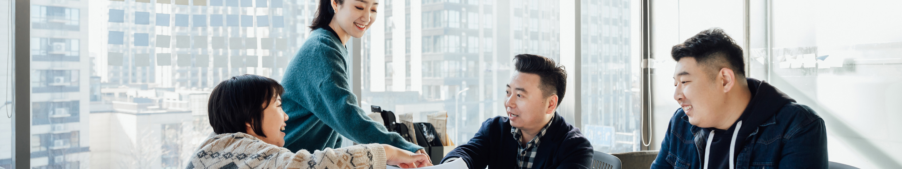
Networking and Relationship Building
Get to know people. Build relationships. Build partnerships.
Facilitated By:
Ryan Taylor, Organizer & Facilitator
Golden Gift Consulting /
GHS Communications Consulting Management & Business Development Consulting | Communications & Marketing
Facilitated By:
Cedric Austin, Organizer & Facilitator
Washington State Department of Enterprise Services Community Engagement Specialist
Procurement Inclusion and Equity Program | Public Works Business Diversity Program

Slide 17
What happens during our Networking and
Relationship Building portion of the meeting?
During our facilitated networking section, we select a topic to discuss as a group. Small businesses, organizational representatives and other participants share their experience regarding the topic.
Participants and facilitators engage in active listening and discuss thoughts and ideas that could be helpful.

Slide 18

Today’s Topics
Topics for Small Businesses, GCs and Organizational Representatives:
1.What are your recent “WINs” in public and private contracting, or your related program work?
2. What do you believe you will need to grow your business or program to the next level?

Slide 19

Questions
Do you have any questions for our facilitators?

Slide 20
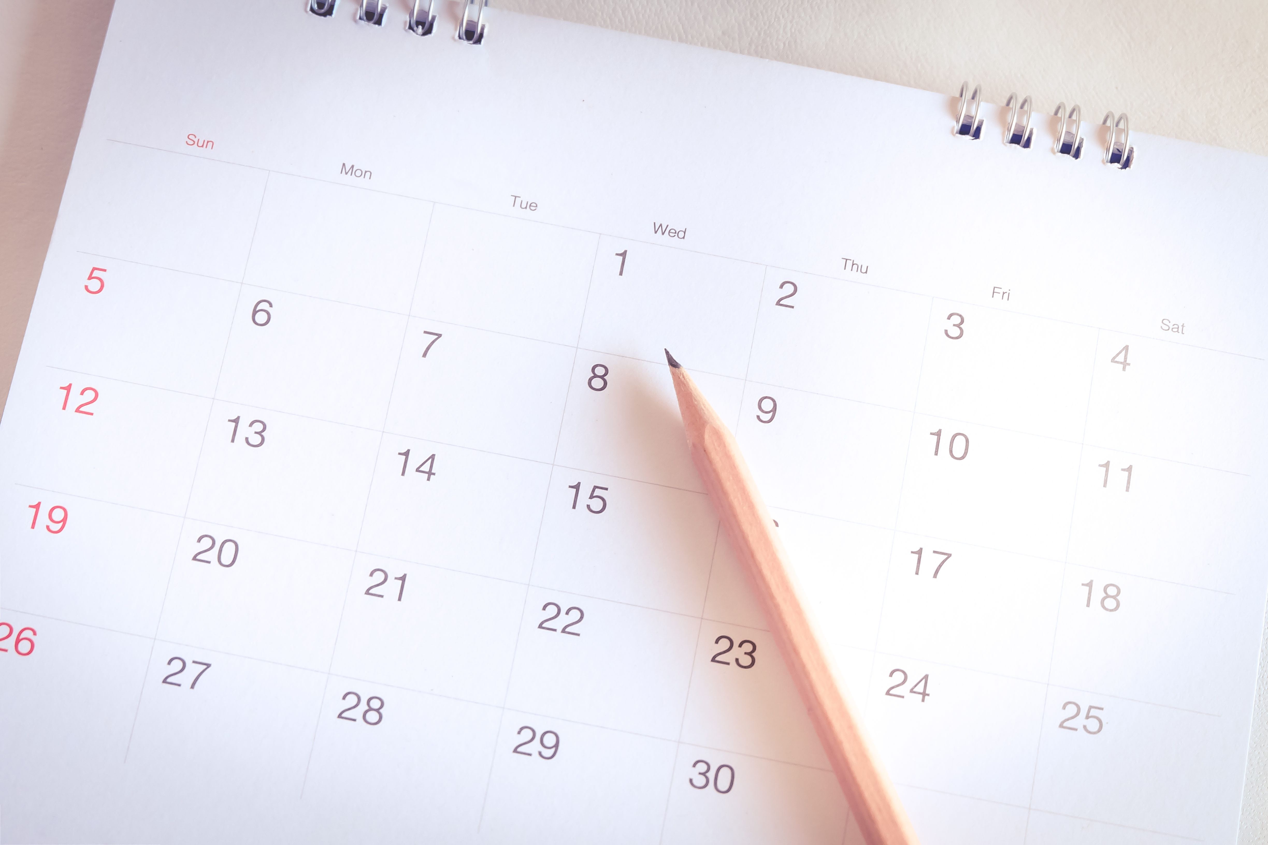
Thank You for Attending
Our next meeting will be held on
MS Teams on
Monday, July 20, 2026
12:00 pm Pacific

